Slide 1
Company Profit Analysis Using Excel
STUDENT NAME : Rakesh
REGISTER NO : 312207322
DEPARTMENT : COMMERCE
COLLEGE : CKNC

Slide 2
COMPANY PROFIT ANALYSIS USING MICROSOFT EXCEL

Slide 3
AGENDA
Problem Statement
Project overview
End Users
Our solution
Dataset Description
Modeling Approach
Results and Discussion
Conclusion

Slide 4
PROBLEM STATEMENT :
To analyse the salary manufacture production sale income and profit of a company. To find the profit trend analyse revenue and cost department performance seasonality and external factors using microsoft excel’s pie chart, flow chart, bar diagram and pivot table.

Slide 5
PROJECT OVERVIEW:
Our project aims to analyse the overall sale and profit of a company.
We seek accurately the turnover of the company.
The excel will expose the overall performance of the company.

Slide 6
WHO ARE THE END USERS?
Company management
Share holders
Financial regulatory authority
Public offerors

Slide 7
OUR SOLUTION AND ITS VALUE PROPOSITION:
We propose the full detail of the company’s sales financial position and profit using the data set given to us.
The proposed excel exhibits all the details required to go through all the financial details required to know the company.
Our solution expels the monetary value of the company.

Slide 8
THE “WOW” IN OUR SOLUTION:
Yearly profit checklist .
High accuracy in going through the financial statement.
Scalability in the development of the company.

Slide 9
MODELING
Profit Trend Analysis:
Identify the overall profit trend over the last five years. Determine if profits have increased, decreased, or remained stable.
Revenue and Cost Correlation:
Analyze the relationship between revenue and costs to identify key drivers of profitability. Determine whether changes in costs (fixed, variable) or revenue are more strongly associated with profit fluctuations.

Slide 10
Segment/Department Performance:
Break down profits by different segments or departments (e.g., product lines, geographical regions).Identify which segments contribute most to overall profit and which ones may be underperforming
Seasonality and External Factors:
Investigate any seasonal trends in profits and whether external factors (e.g., economic conditions, market trends) have impacted profitability

Slide 11
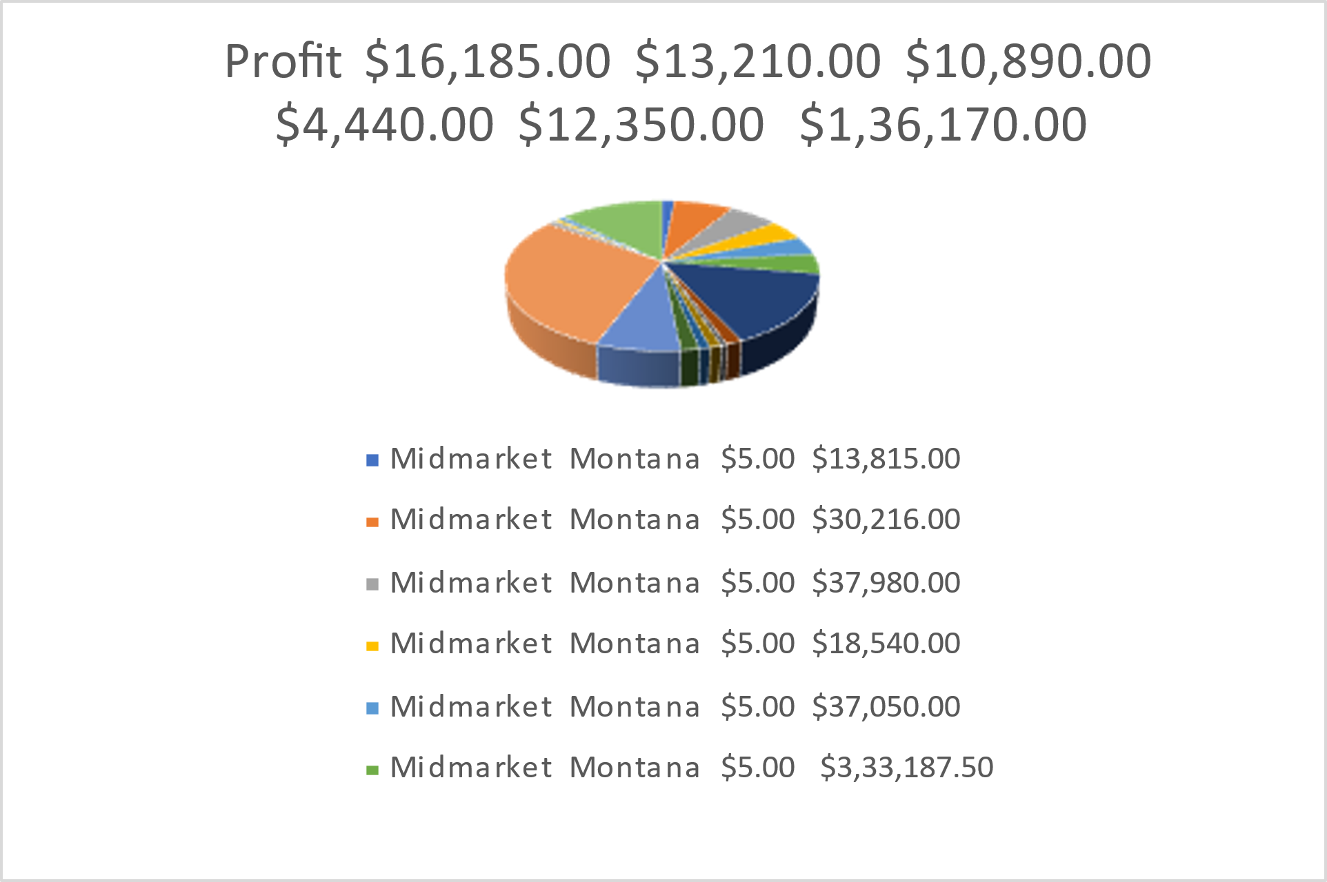
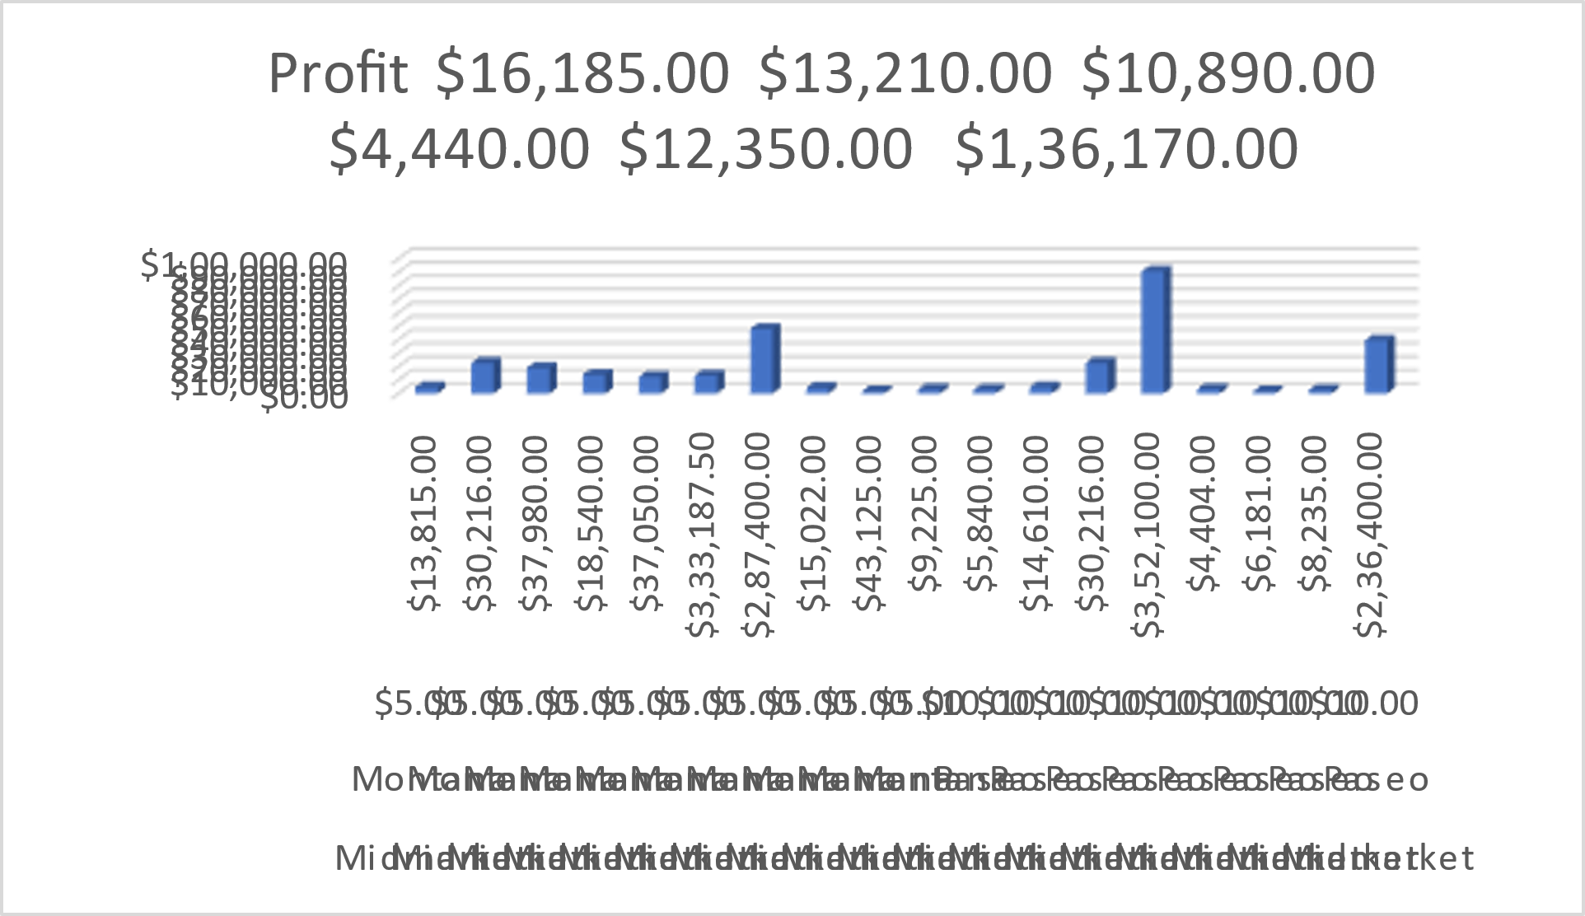
RESULT:

Slide 12
Conclusion:
The above project comprises of the full detailed analysis of a company’s Sales and profits
Anyone can use this project idea to analyse the profits of the companies

Slide 13
THANK YOU!

